Slide 1

Rationale
Introduction to Windows Store App Development Using HTML5 and JavaScript
Computer science is a field of study that deals with solving a variety of problems by using computers.
  To solve a given problem by using computers, you need to design an algorithm for it.
Multiple algorithms can be designed to solve a particular problem.
An algorithm that provides the maximum efficiency should be used for solving the problem.
  The efficiency of an algorithm can be improved by using an appropriate data structure.
Data structures help in creating programs that are simple, reusable, and easy to maintain.
This module will enable a learner to select and implement an appropriate data structure and algorithm to solve a given programming problem.

Slide 2
Objectives
  In this session, you will learn to:
  Implement contracts
Notes:
2

Slide 3


Demo: Implementing the Share Contract
  Problem Statement:
  Ryan has successfully created the Shopping Portal app that displays the details of various products manufactured by the company. Now, he wants to upgrade the functionality of the app. The upgraded version of the app will allow users to share the details of a product, displayed on the app’s UI, with the Mail app in the form of a message. The following details need to be included in the message:
    Product image
    Product name
    Product category
    Product brand
    Product price

Slide 4
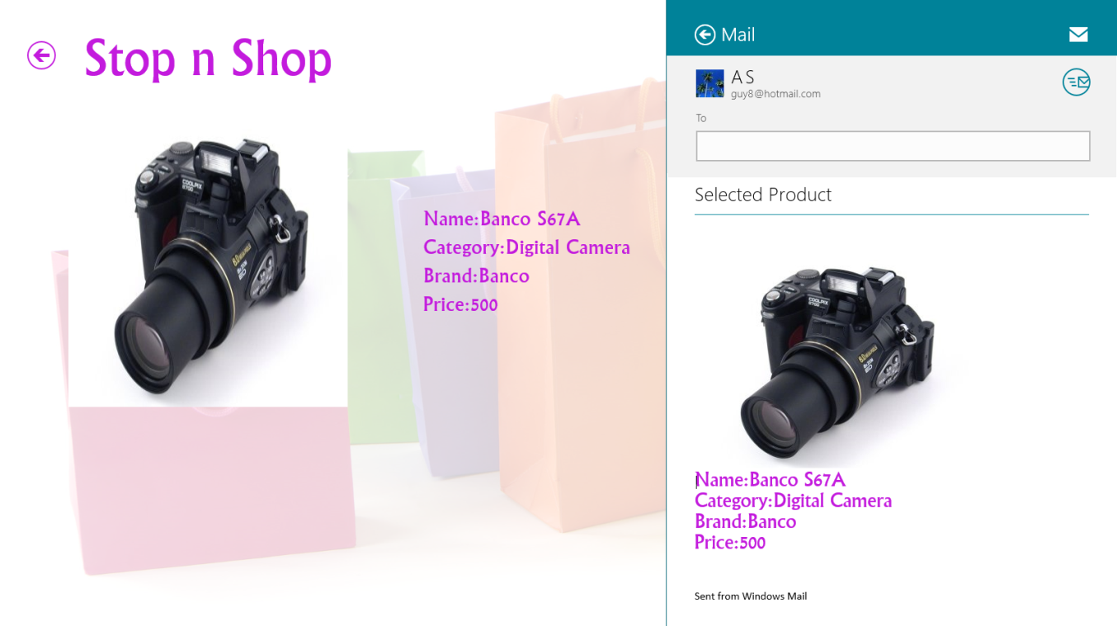
Demo: Implementing the Share Contract (Contd.)
  The following figure shows the message to be shared with the Mail app, when a digital camera, Banco S67A, is displayed on the app UI.

Slide 5
Demo: Implementing the Share Contract (Contd.)
  Help Ryan to implement the preceding functionality in the app.

Slide 6
Demo: Implementing the Share Contract (Contd.)
  Solution:
  To implement the required functionality, Ryan needs to perform the following tasks:
    1. Implement the functionality to share the product details.
    2. Execute the app and verify the output.

Slide 7
Summary
  In this session, you learned that:
  The DataTransferManager class is used to share text, URIs, images, HTML content, rich text, and files among aps through the Share contract.
Notes:
7

Slide 8

Q&A

